Slide 1

https://github.com/datasploit/datasploit
http://datasploit.info | @datasploit

Slide 2

Just another Pen-tester.
Security Consultant @ NotSoSecure
5+ Years of Experience
Twitter - @upgoingstar
Email - upgoingstaar@gmail.com

Slide 3
What’s DataSploit?
Automated OSINT Tool for Domain / Email / Username / IP Addresses
Fetches information from multiple HIDDEN sources.
Works in passive mode.
Written in Python.
Multiple report formats available.
Customized for Pen-testers / Product Security Guys / Cyber Investigators.

Slide 4
Why DataSploit?
So much data.
Server’s Username / Passwords
Address
Email Id
Phone Number
Credentials
Interests
Friends
Preferences
Legacy Machines
Unnecessary Ports Information
Technologies in use, and blah blah..

Slide 5
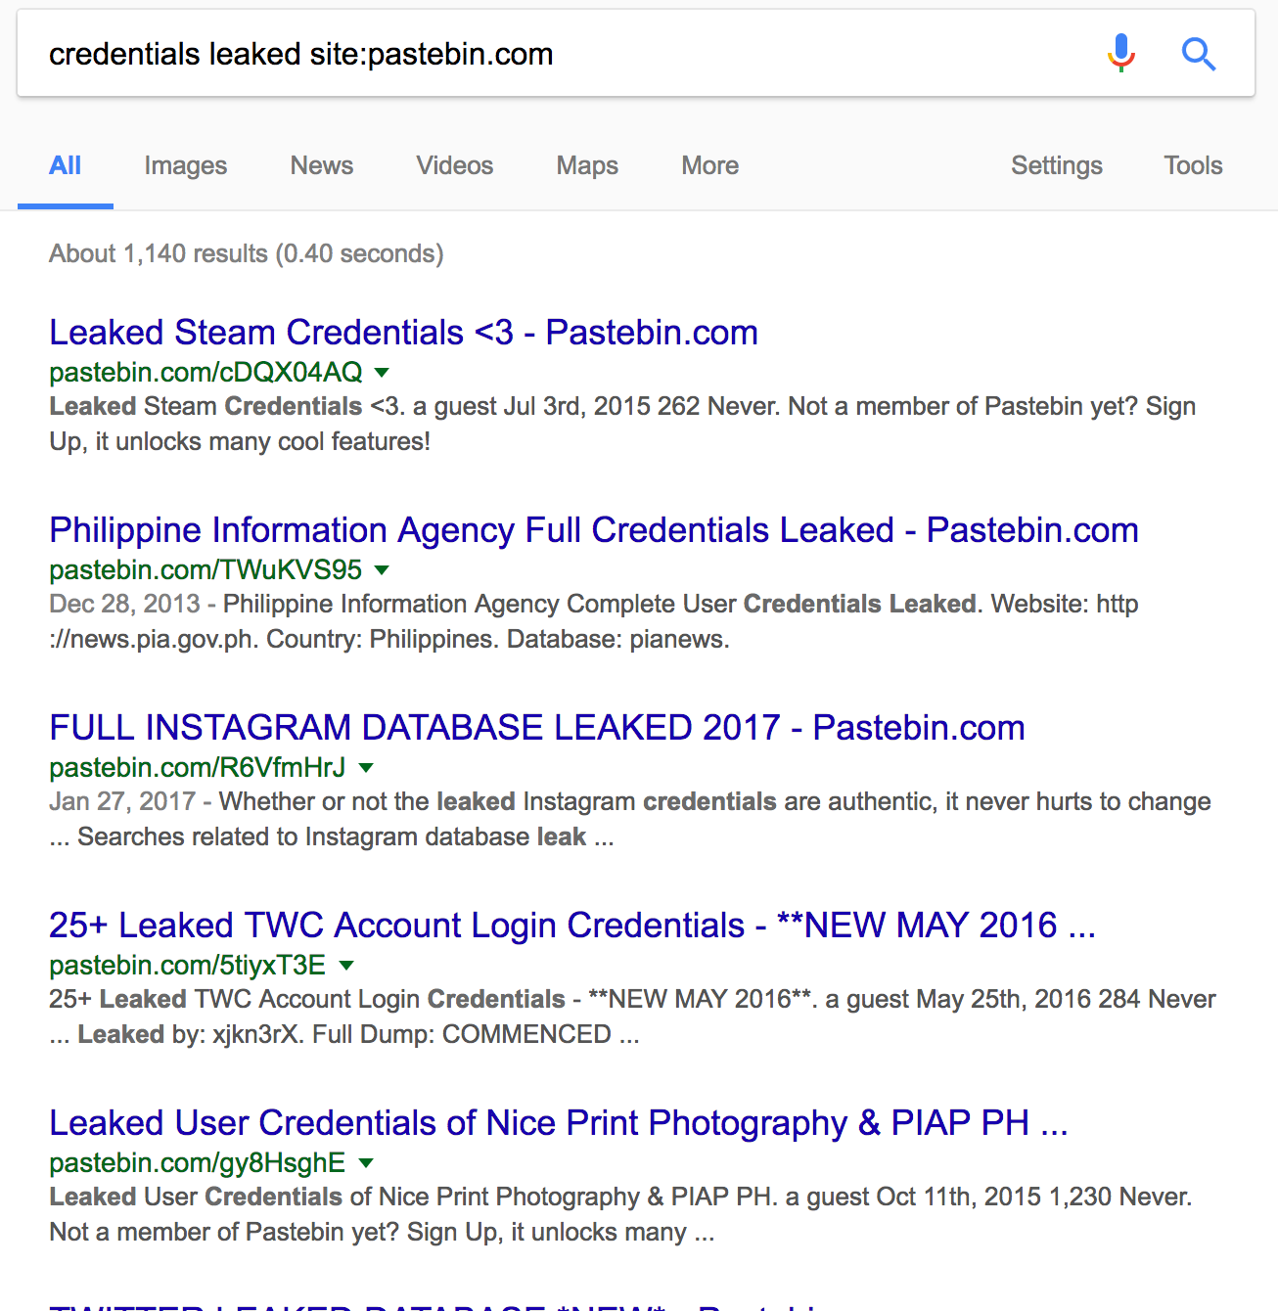
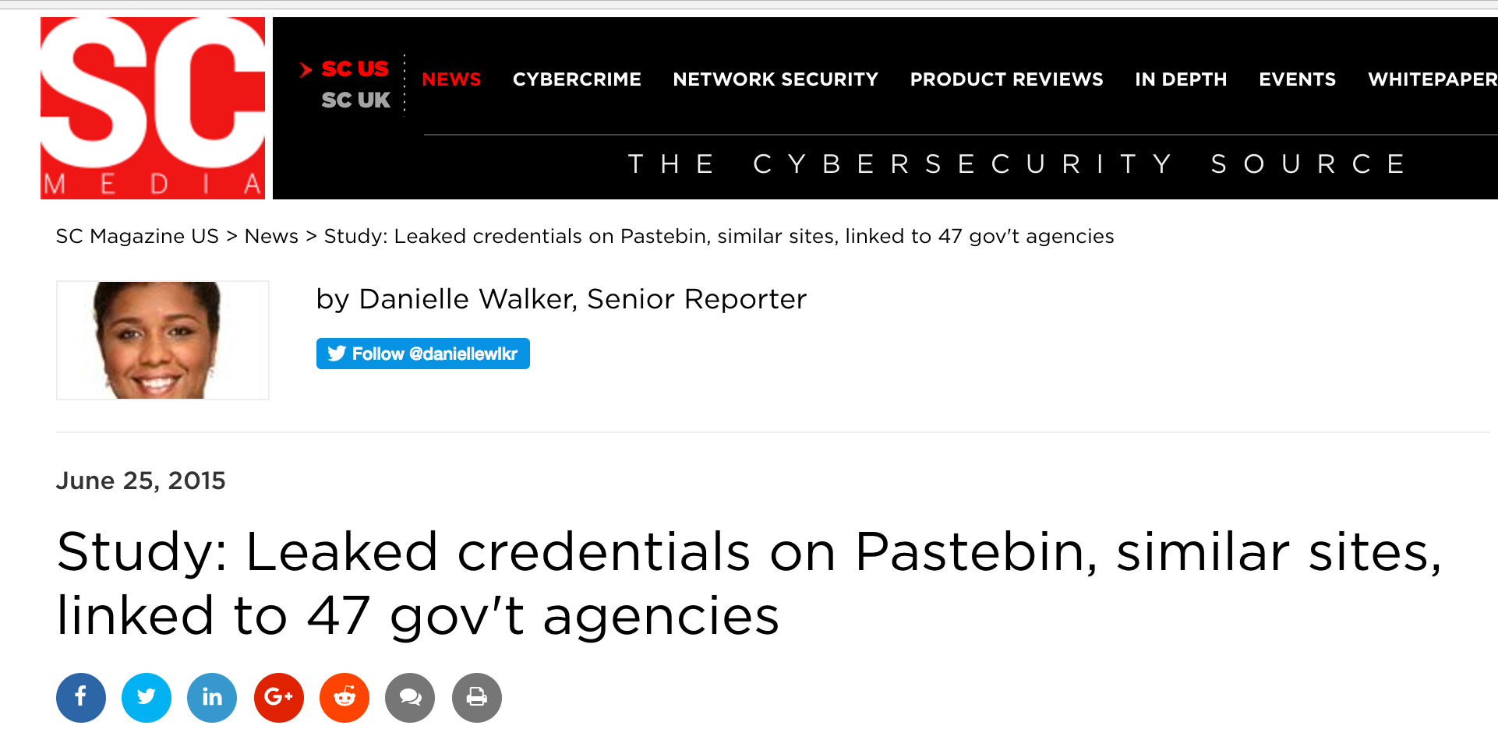
Lets talk real time? History?

Slide 6
Components
Domain Osint
Email Osint
IP Osint
Username Osint
WIP
Company Scoping
Phone Number OSINT
Active Modules

Slide 7
Sources and Flow
Domain:
WhoIS
DNS Records
PunkSpider
Wappalyzer
Github
Email Harvestor →→
Domain IP History
Paste(s) Search
Pagelinks
Wikileaks
Links from Forums
Passive SSL Scan
ZoomEye
Shodan
Censys
Subdomains →→
Email:
Basic Email Checks
Work History
Social profiles
Enumerated Usernames →→
Location Information
Slides
Scribd Documents
Related Websites
HaveIBeenPwned
Username:
Git Details
Check username on various sites.
Profile Pics –Output saved in $username directory
Frequent Hashtags
Interaction on Twitter.
Active Modules

Slide 8
Setting it up..
Manual
Download from git (git clone or download)
git clone https://github.com/DataSploit/datasploit.git
pip install –r requirements.txt
config.py holds API keys
domain_xyz.py – running stand alone scripts.
domainOsint / emailOsint / ipOsint – automated OSINT
active_scan.py
Automated
https://hub.docker.com/r/appsecco/datasploit/
https://hub.docker.com/r/ftorn/datasploit/

Slide 9
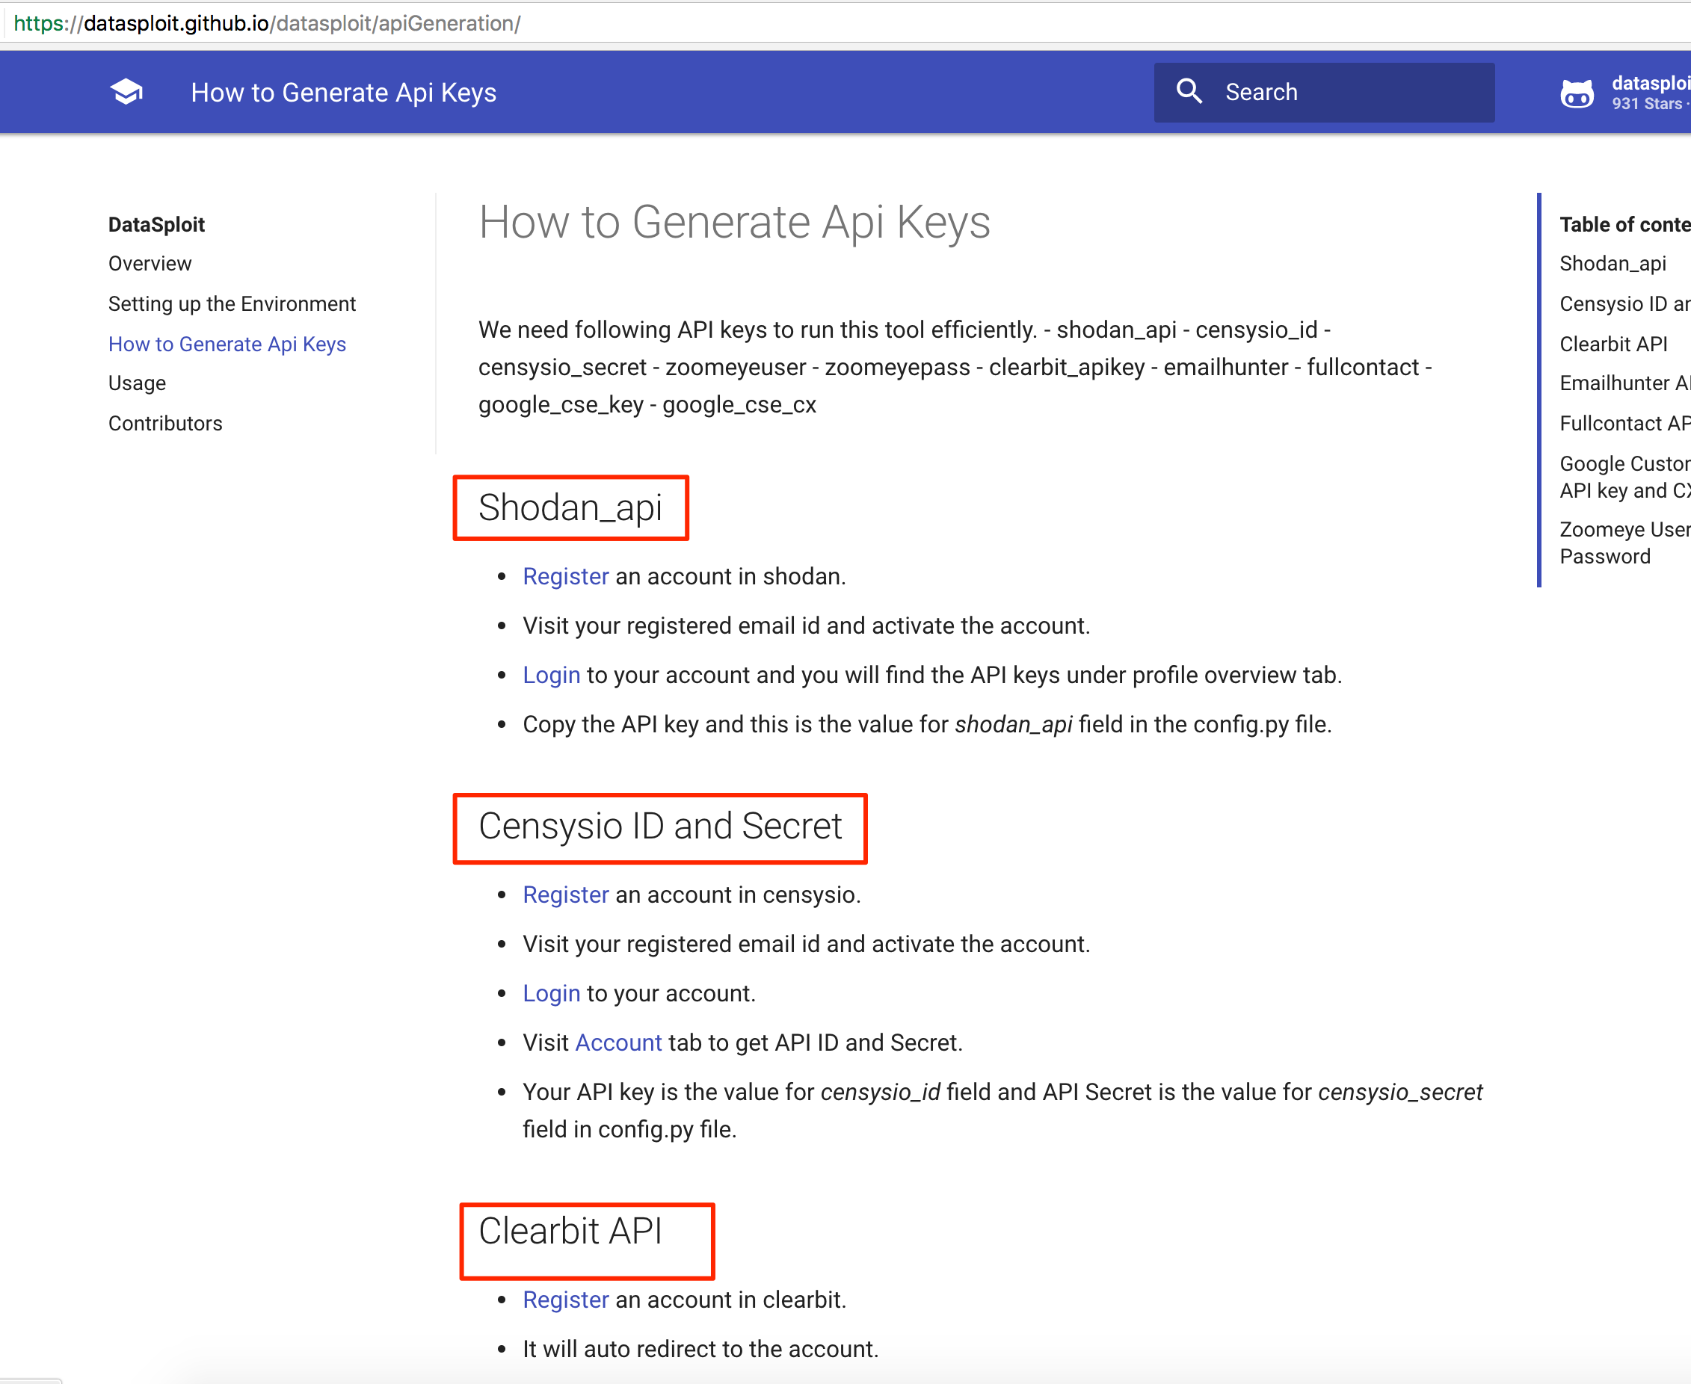
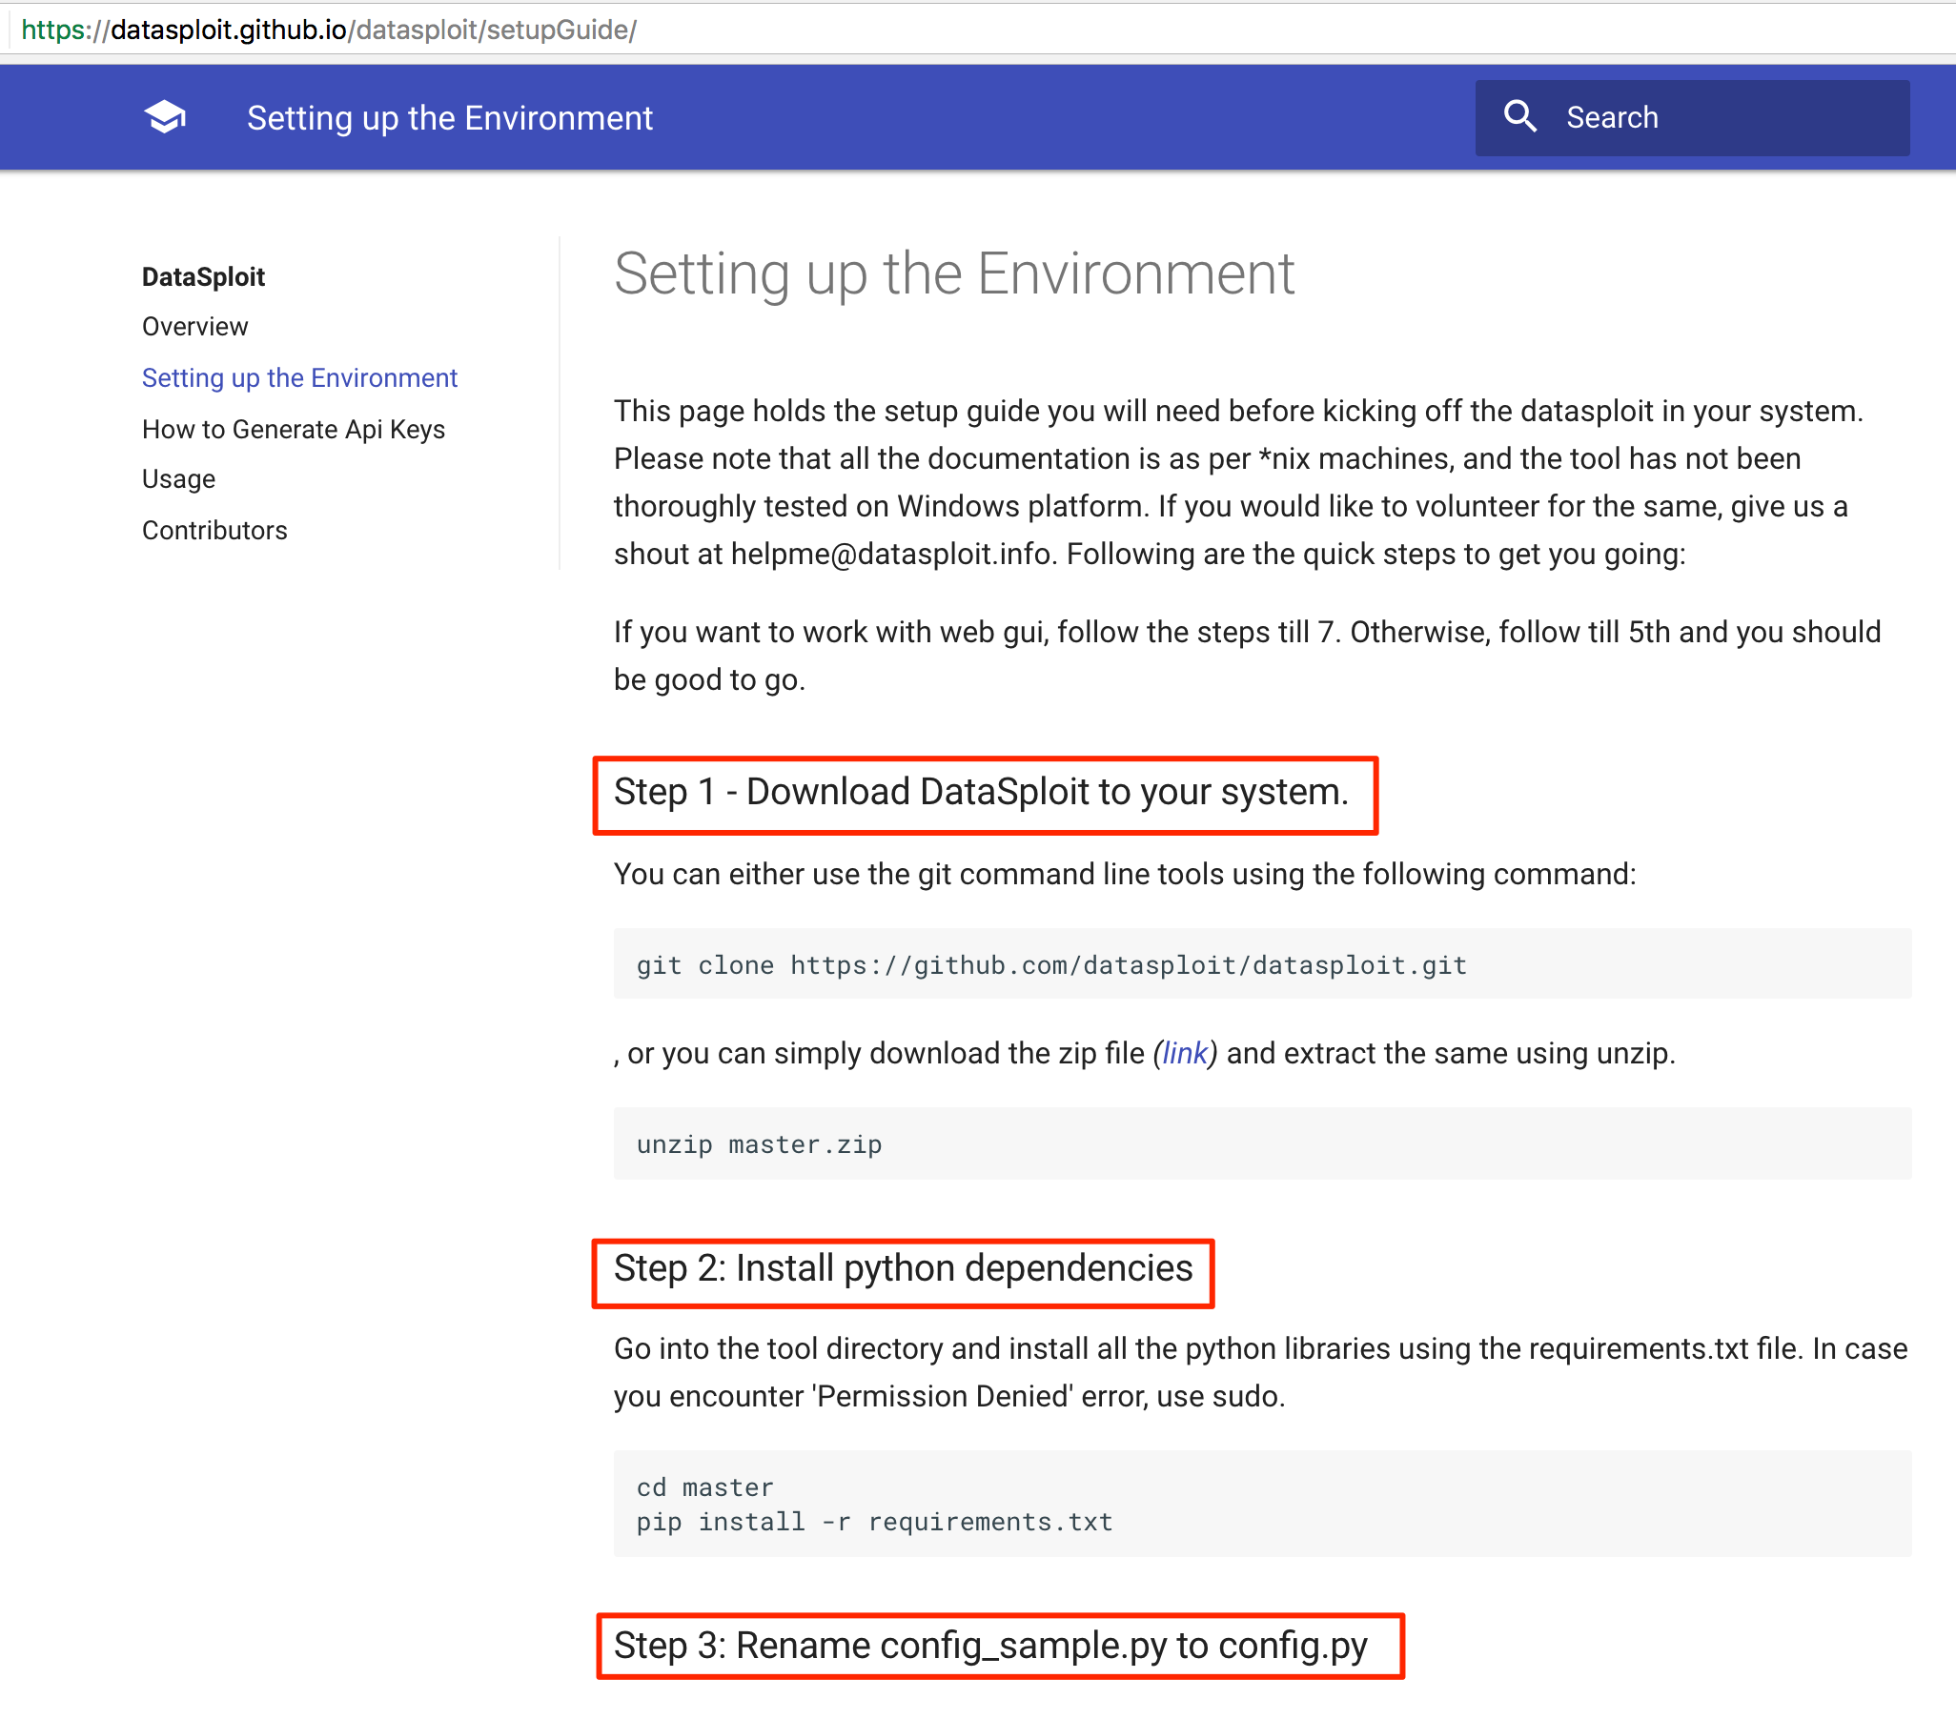
Documentation.
https://datasploit.github.io/datasploit/

Slide 10
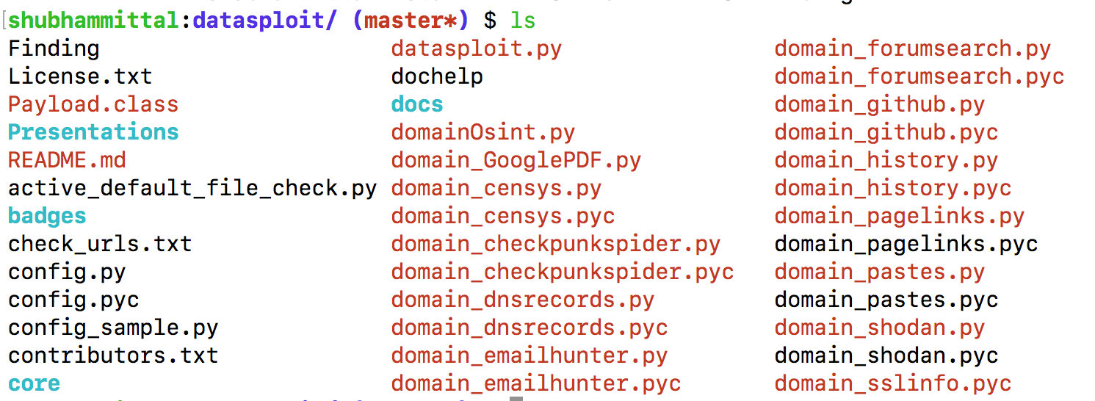
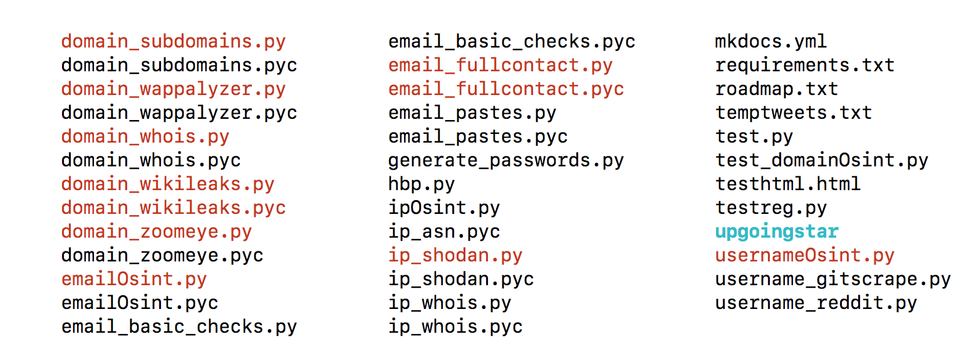
What’s in there?

Slide 11
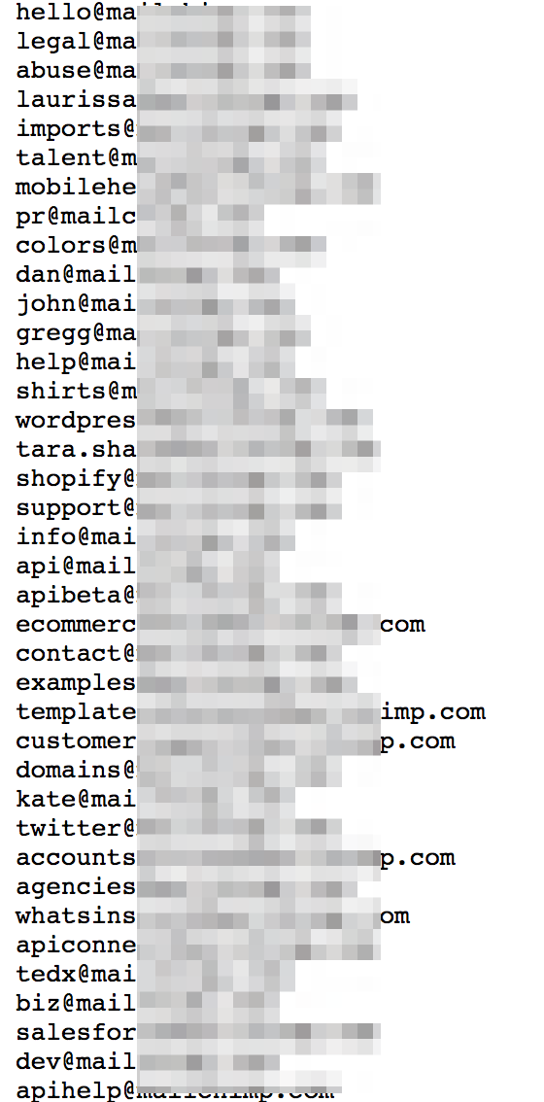
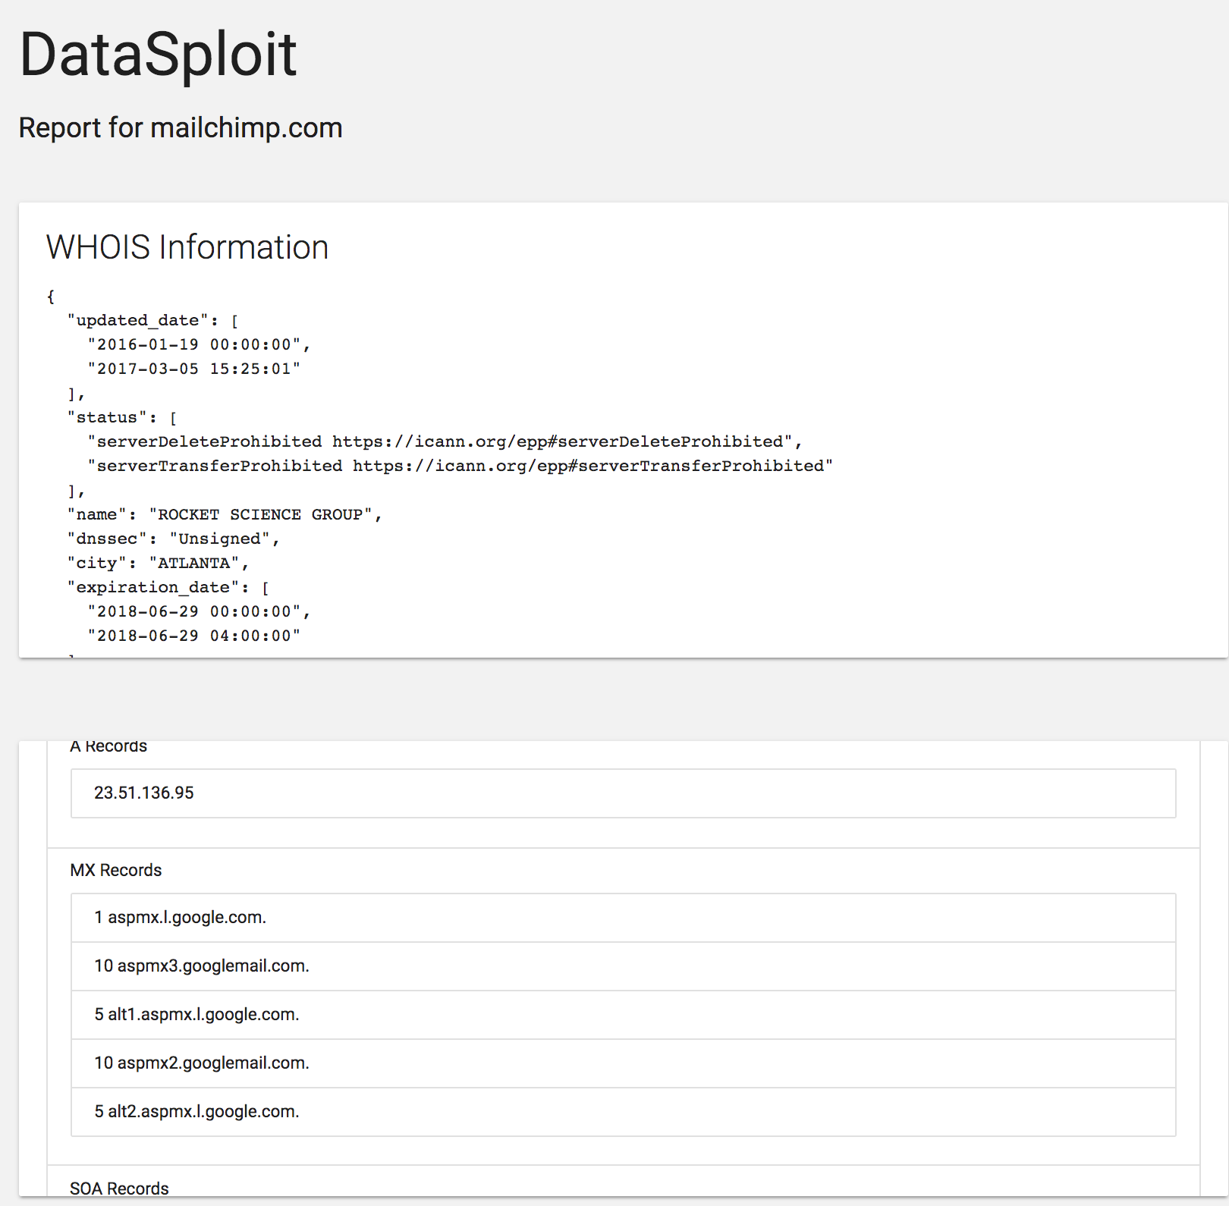
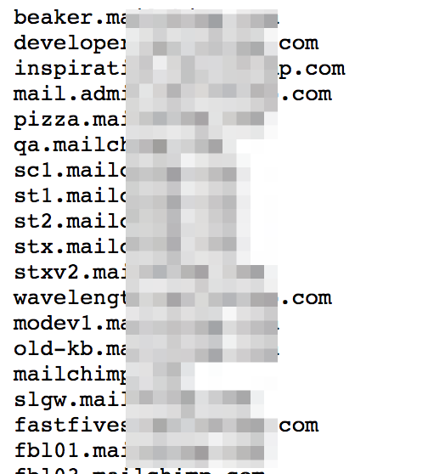
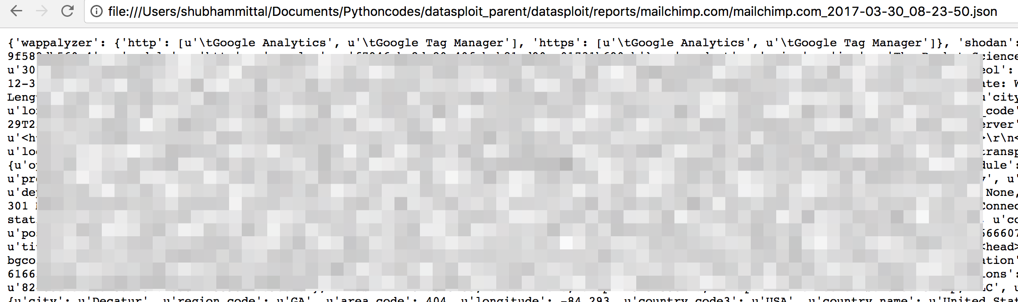
Output Formats
HTML
JSON
Emails List (txt file)
Subdomains List (txt file)

Slide 13
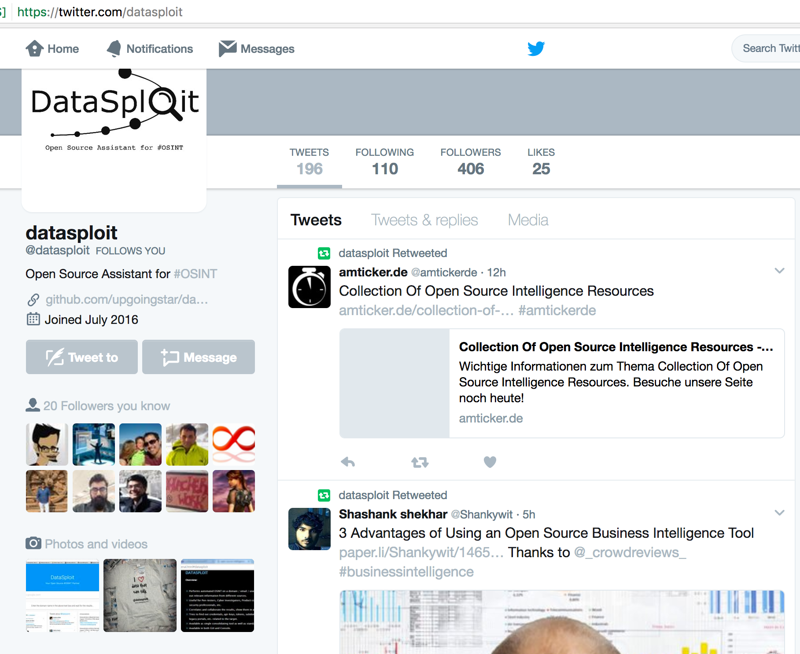
Twitter: @datasploit https://twitter.com/datasploit

Slide 14
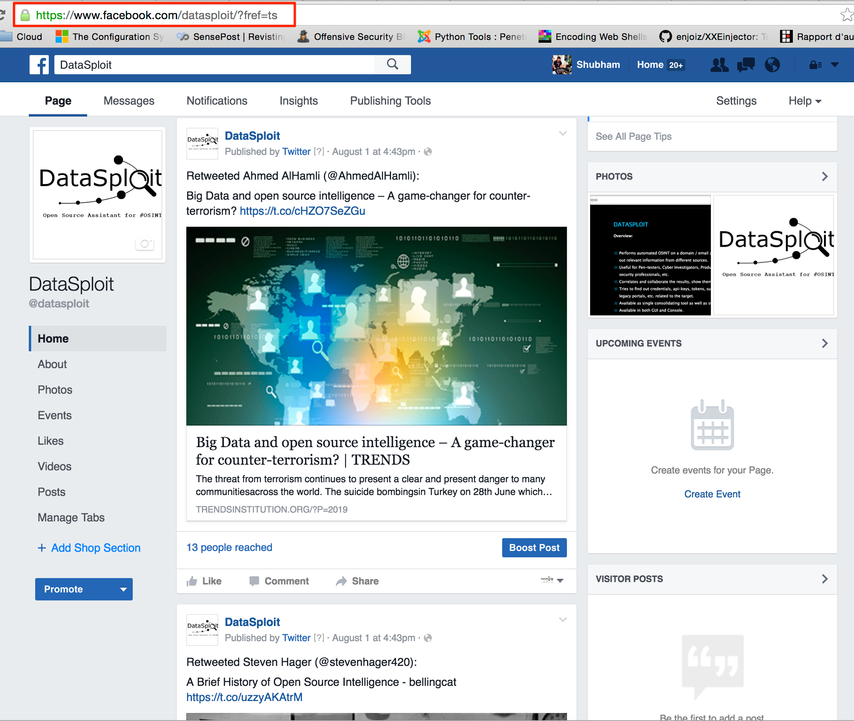
Facebook: /datasploit https://www.facebook.com/datasploit/

Slide 15
Roadmap
Allows to set up periodic scans and alerting for product security companies.
Intelligence on co-relation and identity verification.
Reports in CSV.
Reverse Image Search and profile validation.
Works closely with various social network APIs.
Refine Pastebin and Github Searches.
IP Threat Intelligence.
Organization Scoping.
Integration with SE other tools.
Cloud related OSINT and active modules.
pip install datasploit (to be installed as both library as well as script)

Slide 16









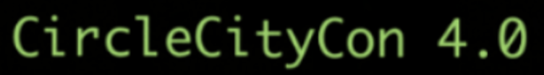



Coverage

Slide 17
How to Contribute
Help us in testing the tool
Expand : Write/Suggest modules
Give Feedback: raise issues, tweet, drop an email.
Use / Promote / Write about the tool.
Write OSINT blogs / tool walkthrough(s) / etc.
Report issues at https://github.com/datasploit/datasploit/issues

Slide 18
Core Contributors.
Shubham Mittal (@upgoingstar)
Nutan Kumar Panda (@nutankumarpanda)
Sudhanshu (@sudhanshu_c)
Kunal (@KunalAggarwal92)
Kudos to
@anantshri for mentoring.
@ bnchandrapal for feedbacks, suggestions and other help around issues.

Slide 19
Thanks. g0t questions?
https://github.com/DataSploit/datasploit
Follow @datasploit for OSINT news and latest updates.
Tweet / DM to @datasploit
upgoingstaar@gmail.com

